Slide 1
Blue Orion
Workshop
Create your own Stellar Token
30.04.2019, Munich
Hans Woppmann, Peter Pansegrau

Slide 2
Blue Orion – Token Workshop Agenda
Introduction of participants
Background Stellar Network + Blue Orion
Tools we use in the workshop
A1: Public and Secret Keys on Testnet and Publicnet
A2: Assets and Trustlines
A3: Send and receive XLM and tokens
A4: Create your own token with your selected name (Testnet + Publicnet)
Note:
around 90 min presentation
and 15 min per lesson (A1-A4)

Slide 3

Blue Orion – Token Workshop Short Introduction

Slide 4
Blue Orion – Token Workshop Agenda
Introduction of participants
Background Stellar Network + Blue Orion
Tools we use in the workshop
A1: Public and Secret Keys on Testnet and Publicnet
A2: Assets and Trustlines
A3: Send and receive XLM and tokens
A4: Create your own token with your selected name (Testnet + Publicnet)
Note:
around 90 min presentation
and 15 min per lesson (A1-A4)

Slide 5
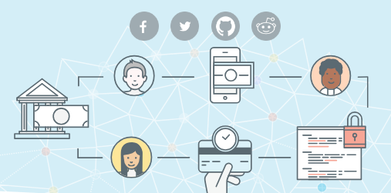
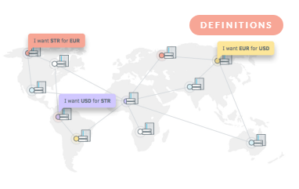
Blue Orion – Token Workshop
Background Stellar Network
Stellar is a platform that connects banks, payments systems, and people. Integrate to move money quickly, reliably, and at almost no cost.
Decentralized Network: Stellar.org
Additional Information: https://www.lumenauts.com/explainers/stellar-assets-and-anchors

Slide 6

Smart Stellar – Crypto Services
Stellar Key Values
Crypto
Features
Stellar is one of the fastest and scalable coins on the market. Transactions are done within 2-5 sec. and the network scales up to 1000 transactions per second. Stellar also has very low transaction fees which doesn’t depend on traffic like Bitcoin or Ethereum.
Tokens and Anchors
Stellar has an integrated asset platform which supports the creation of new tokens. New tokens can be traded immediately on the distrubuted Stellar exchanges like StellarX. Stellar also supports the creation of so called anchors. Anchors are entities in the Stellar network which can hold a deposit and issue credits as and when required.
Smart
Contracts
Stellar provides “Smart Contract” functionalities, like timebound payments, multi signature accounts and weighted signatures. This enables a set of Smart Contracts which are sufficient for most token requirements. Also Smart Contracts do not require additional costs to be executed (unlike Ethereum).
Stellar has a long list of successful partners: IBM, Deloitte, stripe and many more. See stellar.org/about/directory and also for IBM ibm.com/blogs/blockchain/2018/07/stable-coins-enabling-payments-on-blockchain-through-alternative-digital-currencies/
Economy Partner
For more details see also blockgeeks.com/guides/what-is-stellar-blockchain/

Slide 7
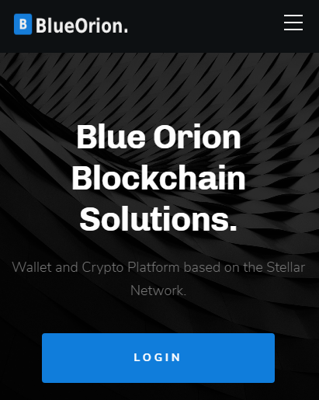


Blue Orion – Token Workshop
Background Blue Orion
Personal Motivation
Blue Orion is a Crypto Wallet,
has a focus on special services which are not provided elsewhere in the crypto space and
a strong security approach (secret keys are not transmitted to our server, non-custodial wallet).
There are no funds held at any time by the application or server.
See smartstellar.org for a live demo

Slide 8
Blue Orion – Token Workshop Agenda
P
Introduction of participants
Background Stellar Network + Blue Orion
Tools we use in the workshop
A1: Public and Secret Keys on Testnet and Publicnet
A2: Assets and Trustlines
A3: Send and receive XLM and tokens
A4: Create your own token with your selected name (Testnet + Publicnet)
Note:
around 90 min presentation
and 15 min per lesson (A1-A4)

Slide 9

Blue Orion – Token Workshop Tools we will use during the workshop
P
Tools to be used in the workshop
Text Editor To store all the keys created in the workshop
Stellar Laboratory Webinterface provided from the Stellar Foundation https://www.stellar.org/laboratory/
Stellar Expert Account and Asset Explorer https://stellar.expert/explorer/public/
Smart Stellar Web-Wallet Web-Wallet developed by Blue Orion (http://blueorion.cc/) https://smartstellar.org/

Slide 10
Blue Orion – Token Workshop Agenda
P
Introduction of participants
Background Stellar Network + Blue Orion
Tools we use in the workshop
A1: Public and Secret Keys on Testnet and Publicnet
A2: Assets and Trustlines
A3: Send and receive XLM and tokens
A4: Create your own token with your selected name (Testnet + Publicnet)
Note:
around 90 min presentation
and 15 min per lesson (A1-A4)

Slide 11

Blue Orion – Token Workshop Lesson A1: Content
P
Lesson Goals A1
Understand public and secret keys
Create keys/accounts on TestNet + PublicNet
Fund the accounts with Friendbot
Check balance with account viewer

Slide 12
Blue Orion – Token Workshop Lesson A1: Understanding public and secret keys
P
An account is represented by Public and Secret Key
(The secret key is sometimes also called the “Secret Seed”)
Keys will be created based on a specific crypto algorithm
(based on ED25519, see also https://en.wikipedia.org/wiki/EdDSA)
Public Key comparable with bank account number
56 Characters
Starts with a “G”
e.g.: “GBITJ65YIQGIDHJEPEFW33RDXDLU7U3NRVNAAIJA424GGKGPB2I66KVB”
Secret Key comparable with password
56 Characters
Starts with a “S”
e.g.: “SA4CNBDDTZVCNQMBCI6HCUKNQE35EBS3EBZ2AX6XXJZ4MGFIVBMWH34U”
Note: The secret key includes the public key. By using a crypto function you can get the public key from the secret key. BUT based on the existing math algorithm and computing power on earth it is not possible to do it the other way around :-)
Note: For digital signature there exist a hash function (based on ed25519), too, that make it possible to check via public key if a given signature was created by related secret key.
Note: Why is it safe? It’s a little bit of mathematics …
26 characters plus 10 digits ends up in 36 mutations
on 56 positions
there are almost endless variations
in detail a 8 filled with 62 zeros
Number of stars in the universe: 3 with 23 zeros
Atoms on earth: 1 with 50 zeros
Atoms in our galaxy (milky way): 1 with 68 zeros

Slide 13
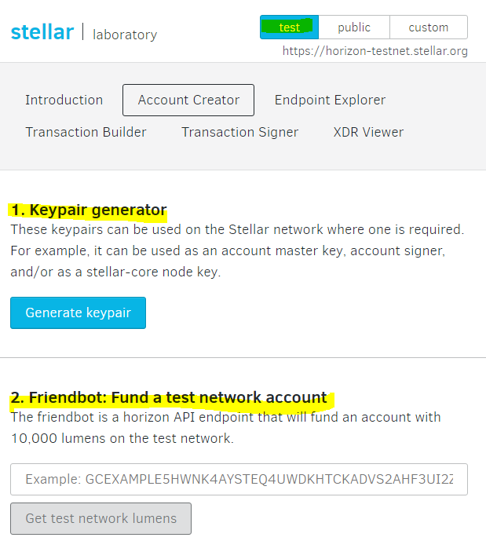
Blue Orion – Token Workshop Lesson A1: Create & activate an account (via laboratory)
P
TestNet
https://www.stellar.org/laboratory/
Create Keys
Generate
Safe keys
Activate Account
Fund with “Friendbot” on TestNet
Note: A new Stellar account needs to get activated by sending lumen to that account from another existing account (Minimum 0.5 lumen, to have some value left for fees, at least 1 lumen is recommended)

Slide 14
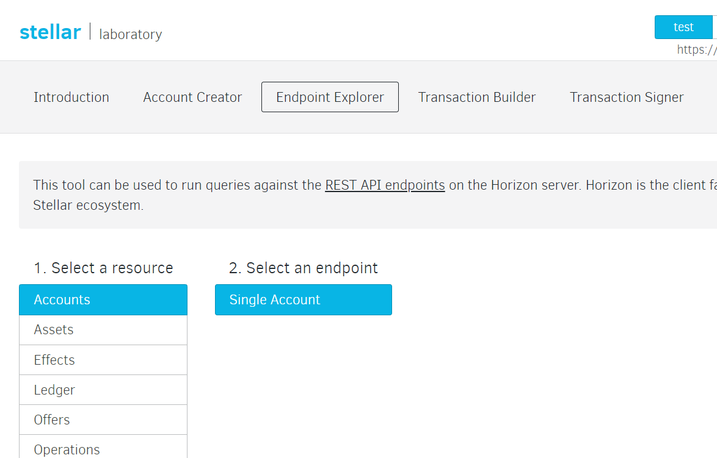
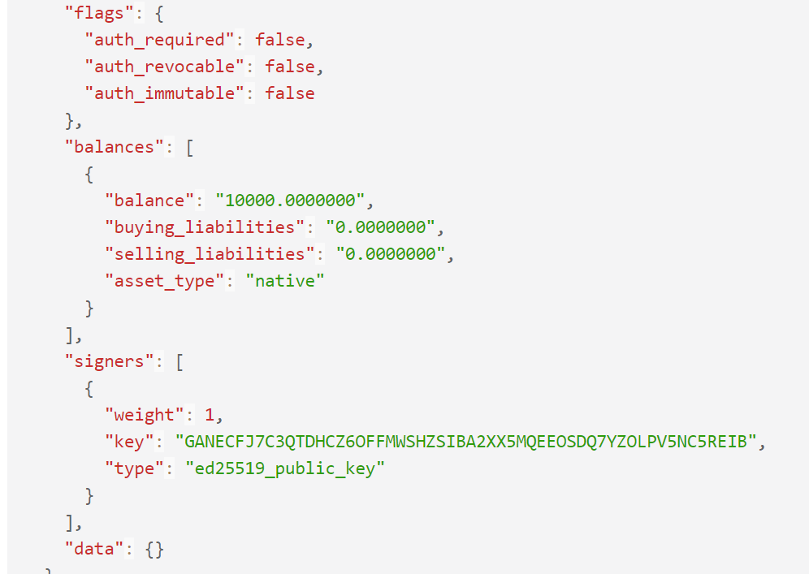
Blue Orion – Token Workshop Lesson A1: Check account & balance (via laboratory)
P
TestNet
https://www.stellar.org/laboratory/

Slide 15
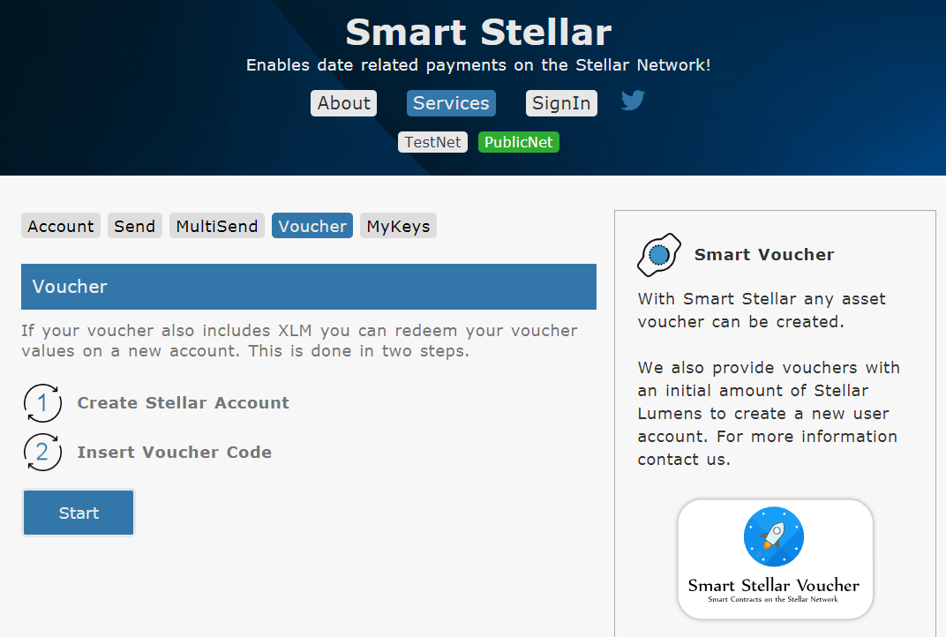
Blue Orion – Token Workshop Lesson A1: Create & activate an account (via wallet)
P
PublicNet
https://www.smartstellar.org/myvoucher
Create Keys on PublicNet with Smart Stellar by using a voucher.

Slide 16
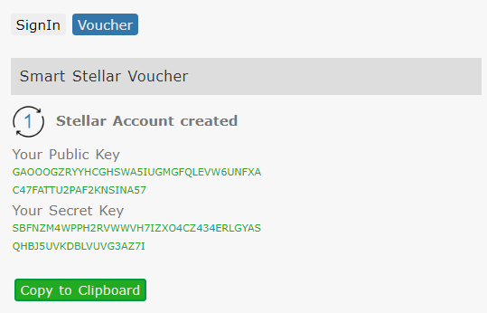
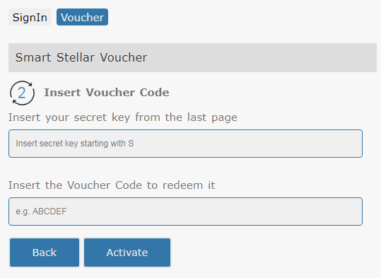
Blue Orion – Token Workshop Lesson A1: Create & activate an account (via wallet)
P
PublicNet
https://www.smartstellar.org/myvoucher
Voucher Redemtion in 2 Steps

Slide 17
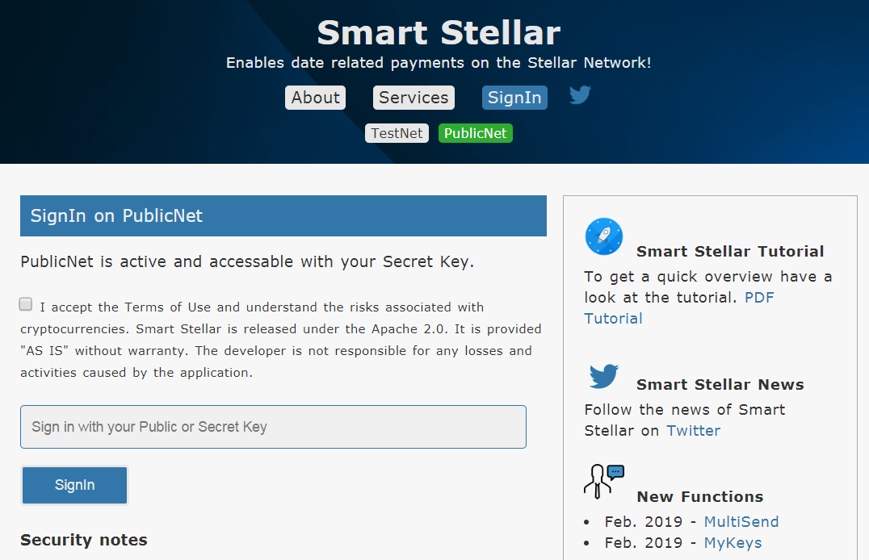
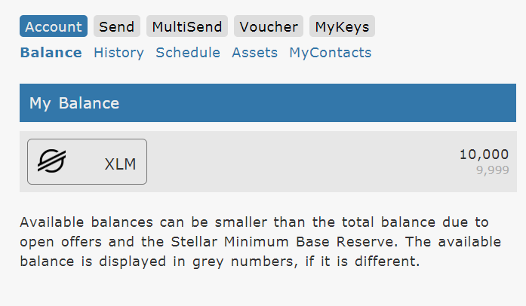
Blue Orion – Token Workshop Lesson A1: Check account & balance (via wallet)
P
PublicNet
https://www.smartstellar.org/myvoucher

Slide 18

Blue Orion – Token Workshop Lesson A1: Let’s do it
P
A1 Workshop Activity:
Open a text file to store all keys during the workshop
Create one key pair on the TestNet (via laboratory)
Save the keys
Fund the accounts with Friendbot (within laboratory)
Check balance with account viewer and SmartStellar-Wallet
Create one key pair on the PublicNet (use your voucher on the SmartStellar-Wallet)
Check balance with SmartStellar-Wallet

Slide 19
Blue Orion – Token Workshop Agenda
P
Introduction of participants
Background Stellar Network + Blue Orion
Tools we use in the workshop
A1: Public and Secret Keys on Testnet and Publicnet
A2: Assets and Trustlines
A3: Send and receive XLM and tokens
A4: Create your own token with your selected name (Testnet + Publicnet)
Note:
around 90 min presentation
and 15 min per lesson (A1-A4)

Slide 20
Blue Orion – Token Workshop
Lesson Goals A2
Understand assets and trustlines
Add and remove an asset

Slide 21
Blue Orion – Token Workshop
Stellar Native Currency
Short name is XLM, also called “Lumens”
Used as the exchange currency on the stellar network (liquidity, enables exchange path)
Assets (comparable to shares + issuing organization)
An asset can be defined by Asset-Code (code length 1 to 12) and Issuer-Account Issuer: the issuer is defined by the issuing account
Example: the Asset “SMART” is defined by its name and the issuer-key GAG6FFW65DKL3XQ7SQBQVB6MZ4CAEN23VSX5GXUEMXHAEBNPRHQZIKQP

Slide 22
Blue Orion – Token Workshop
Trustline
User agrees to allow a certain token (asset, share) on his account (unlike Ethereum)
Note: Before an account can send you an asset you first need to establish a trustline to this asset

Slide 23
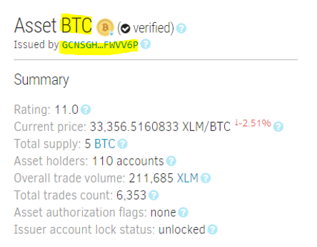
Blue Orion – Token Workshop
Select Asset + Issuer from stellar.expert

Slide 24
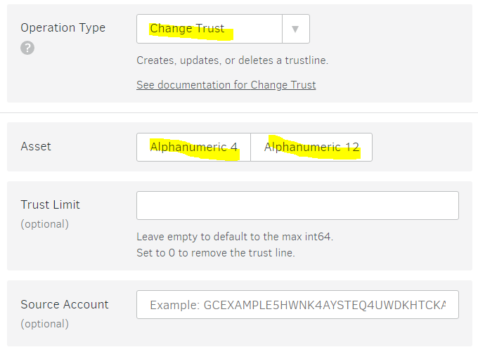
Blue Orion – Token Workshop
Add an asset to your test account on laboratory
Remove asset: Set limit to 0

Slide 25
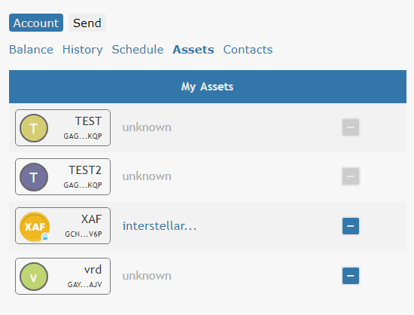
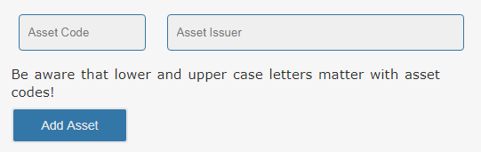
Blue Orion – Token Workshop
Add an asset to your test account on smartstellar.org
Remove asset

Slide 26
Blue Orion – Token Workshop
A2 Worshop Activity:
Choose any asset from stellar.expert
Add an asset to your test account a) with laboratory b) smartstellar.org
Remove asset

Slide 27
Blue Orion – Token Workshop Agenda
P
Introduction of participants
Background Stellar Network + Blue Orion
Tools we use in the workshop
A1: Public and Secret Keys on Testnet and Publicnet
A2: Assets and Trustlines
A3: Send and receive XLM and tokens
A4: Create your own token with your selected name (Testnet + Publicnet)
Note:
around 90 min presentation
and 15 min per lesson (A1-A4)

Slide 28
Blue Orion – Token Workshop Lesson A3: Content
P
Lesson Goals A3
Send XLM and tokens on TestNet
Check History

Slide 29
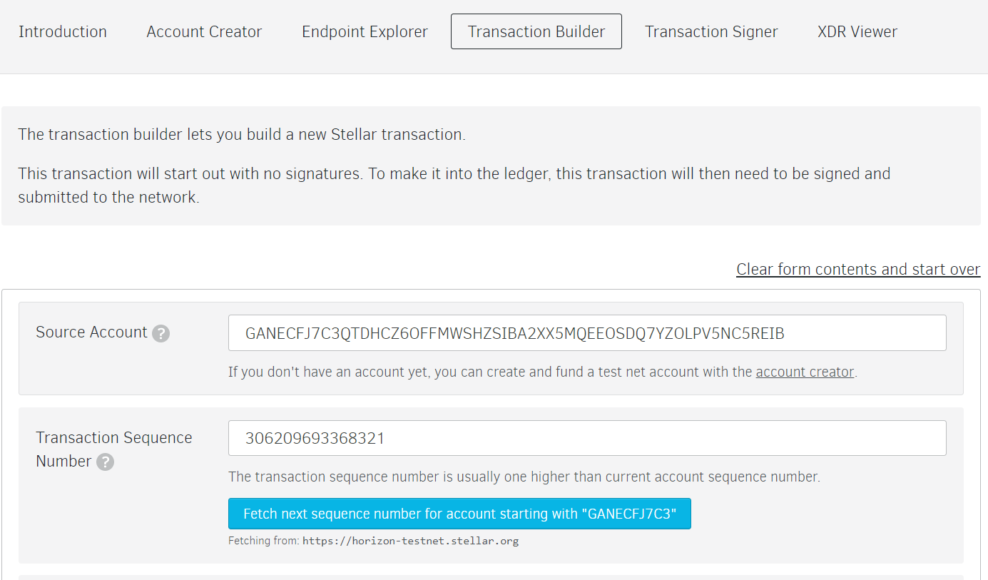
Blue Orion – Token Workshop Lesson A3: Send XLM and tokens 1/3 (via laboratory)
P
TestNet
https://www.stellar.org/laboratory/
Use the “Transaction Builder”
fill in the PUBLIC KEY of your source account
feth a sequence number (just a technical thing)

Slide 30
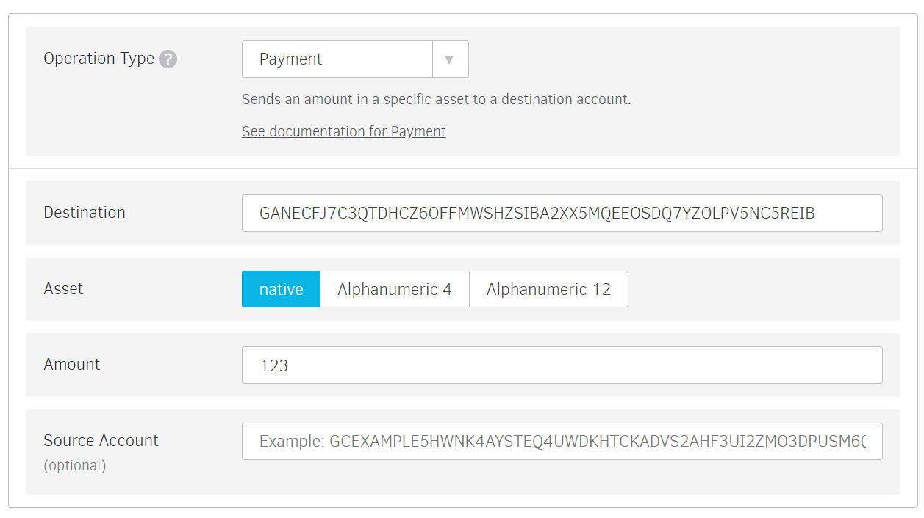
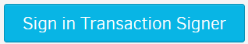
Blue Orion – Token Workshop Lesson A3: Send XLM and tokens 2/3
P
TestNet
https://www.stellar.org/laboratory/
Select “Payment”
fill in the PUBLIC KEY of your destination account
choose the asset and amount (native means XLM)

Slide 31
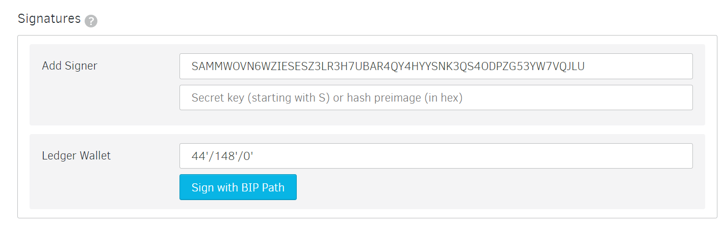
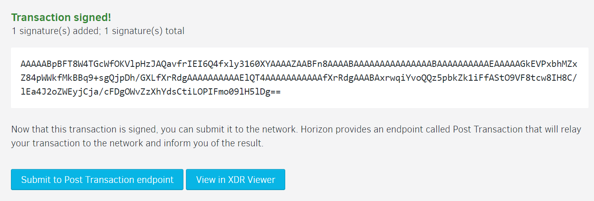
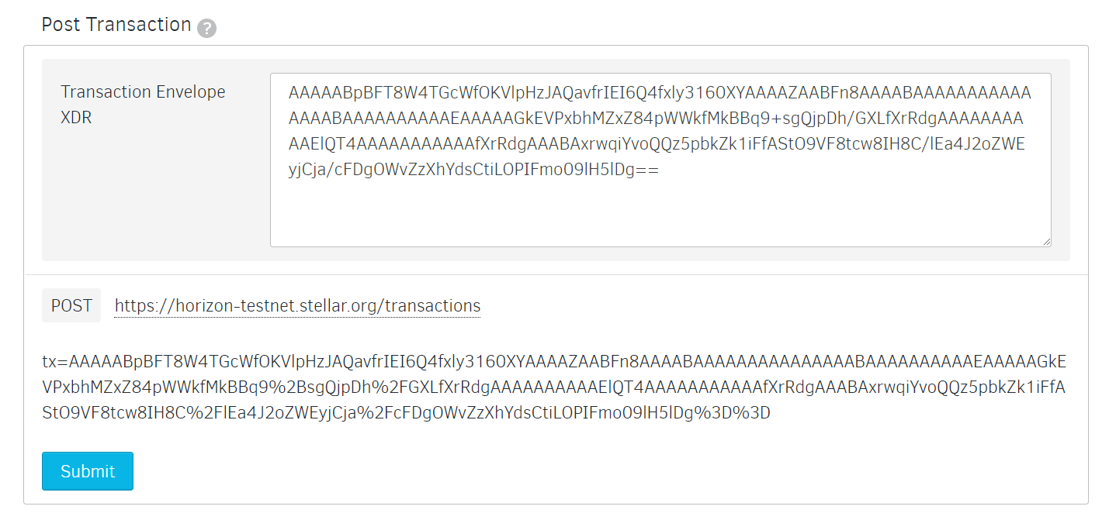
Blue Orion – Token Workshop Lesson A3: Send XLM and tokens 3/3
P
TestNet
https://www.stellar.org/laboratory/
Sign the transaction
now you have to fill in your SECRET KEY
and confirm … … …

Slide 32
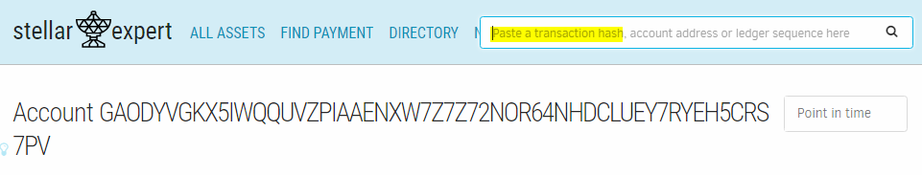
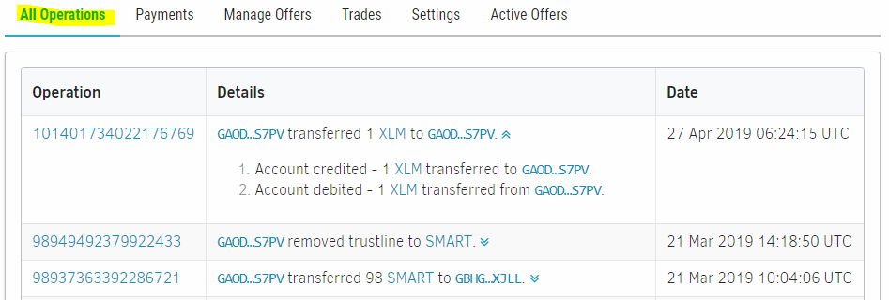
Blue Orion – Token Workshop Lesson A3: Check balance & history
P
TestNet
https://stellar.expert/explorer/testnet/
Paste your PUBLIC KEY

Slide 33
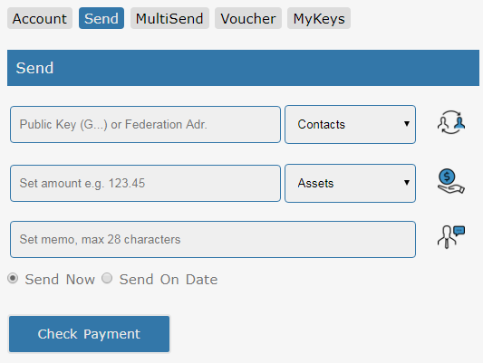
Blue Orion – Token Workshop Lesson A3: Send XLM and tokens 1/1 (via wallet)
P
TestNet
https://www.smartstellar.org/signin
Send XLM with Blue Orion
Login with your SECRET KEY

Slide 34
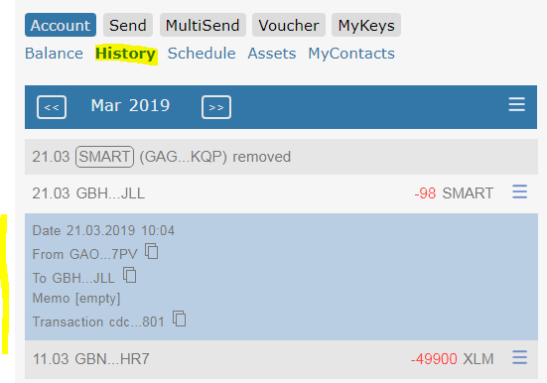
Blue Orion – Token Workshop Lesson A3: Check balance & history (via wallet)
P
TestNet
https://www.smartstellar.org/signin
Move to Account > History

Slide 35
Blue Orion – Token Workshop Lesson A3: Let’s do it
P
A3 Worshop Activity
Send XLM and an asset to your neighbor (use the laboratory or the wallet)
Check the accounts history a) stellar.expert b) Blue Orion Wallet
Note: If you like to share your TestNet PUBLIC KEY with your neighbor you could use the Meetup Message Service

Slide 36
Blue Orion – Token Workshop Outlook - Value add services
Potential of Stellar technology/blockchain
Timed payments
Multi Send service
MyKeys (Multi Account Management)
Proof of Existence

Slide 37
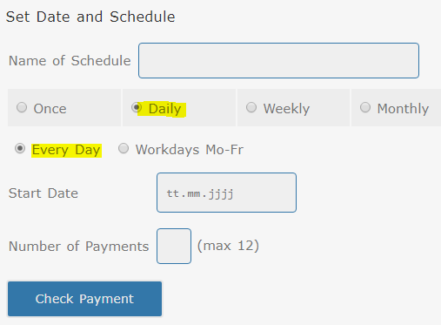
Blue Orion – Token Workshop
Send XLM with Blue Orion, as timed payment

Slide 38
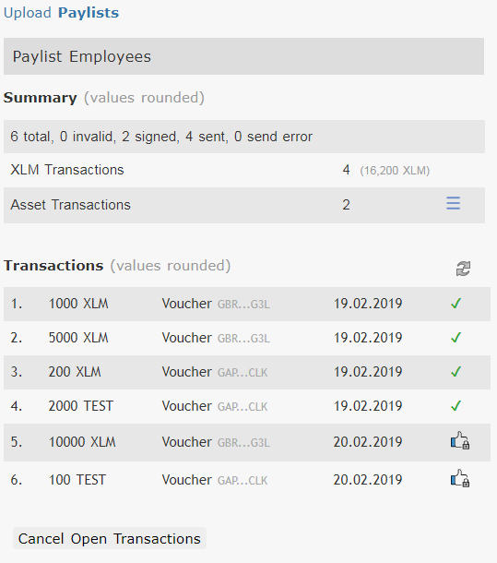
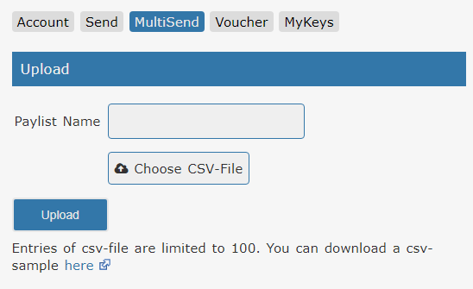
Blue Orion – Token Workshop
MultiSend
Easy send 100 or 1000 payments defined in a CSV-File
Check status of all payments

Slide 39
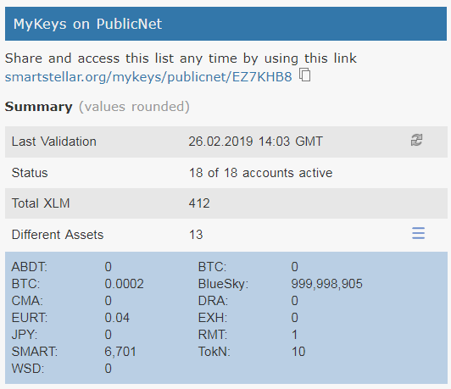
Blue Orion – Token Workshop
MyKeys – Account Summary
MyKeys enables an one page view on all accounts of interest.
The summary shows
Last validation date
If accounts are active or not
Total XLM
Number of different assets and also total amount

Slide 40
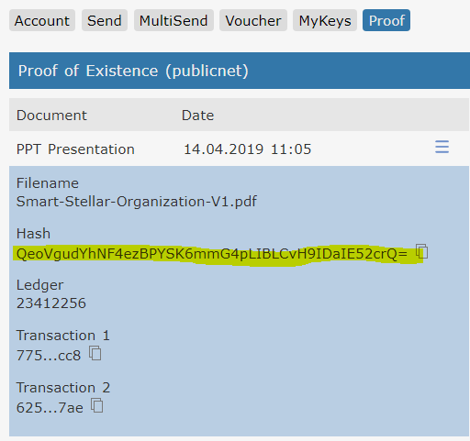
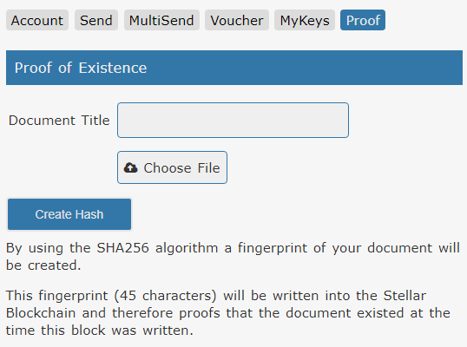
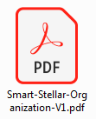
Blue Orion – Token Workshop
Proof of existence (1)
Blockchain solution for securing
intellectual property assets and innovation processes
1a) Create hash of file
1b) Save hash into blockchain

Slide 41
Blue Orion – Token Workshop Agenda
P
Introduction of participants
Background Stellar Network + Blue Orion
Tools we use in the workshop
A1: Public and Secret Keys on Testnet and Publicnet
A2: Assets and Trustlines
A3: Send and receive XLM and tokens
A4: Create your own token with your selected name (Testnet + Publicnet)
Note:
around 90 min presentation
and 15 min per lesson (A1-A4)

Slide 42
Blue Orion – Token Workshop
Lesson Goals A4
Create Issuer Account
Create Distribution Account (or use existing one)
Create Trustline on Distribution Account
Transafer Tokens from Issuer to Distribution Account
Limit Token Number

Slide 43
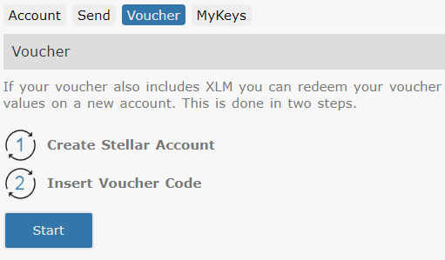
Blue Orion – Token Workshop
Create Issuer Account with voucher
Note: An “Issuer Account” is a normal account which is used to create a new token. The token is identified by token-code and the issuer public key.
Note: To use/distribute tokens The “Issuer Account” provides the tokens to the Distribution Account.
Note: The number of distributed tokens can be limited.

Slide 44
Blue Orion – Token Workshop
Create Distribution Account
Use existing account from publicnet Lesson A1
Note: An “Distribution Account” is used to hold the initial created tokens and transfers the tokens to other accounts.

Slide 45
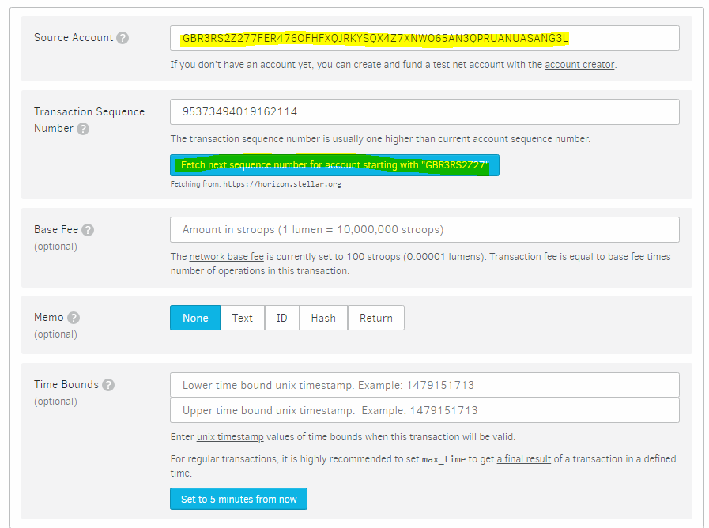
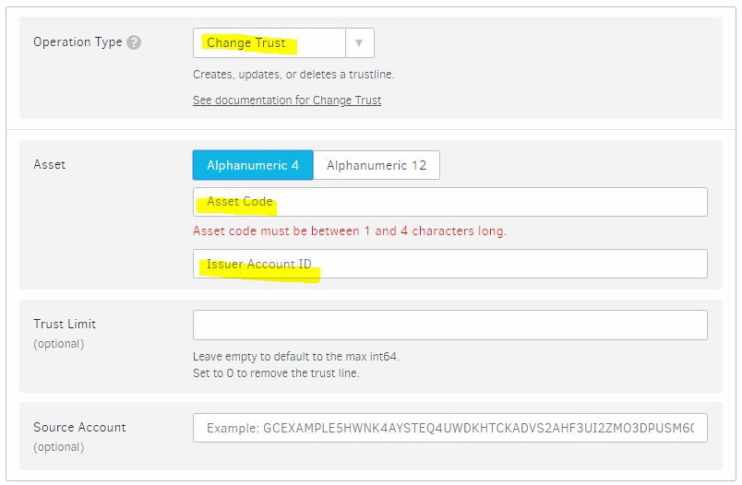
Blue Orion – Token Workshop
Create Trustline on Distribution Account
See Lesson A2

Slide 46
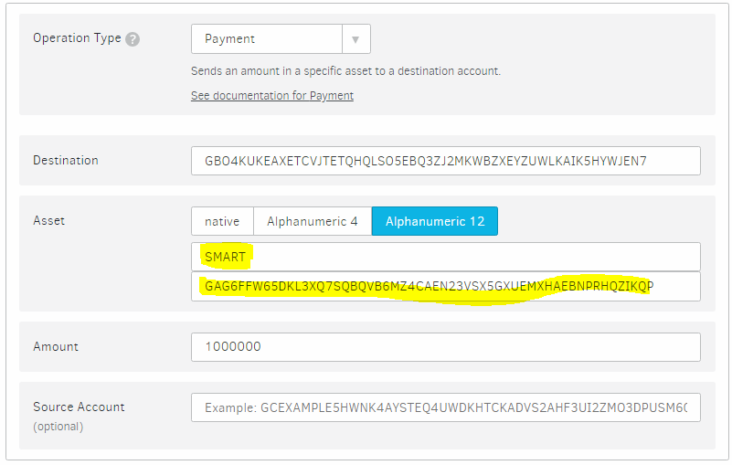
Blue Orion – Token Workshop
Transfer Tokens from Issuer to Distribution Account

Slide 47
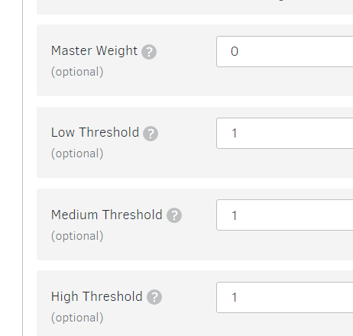
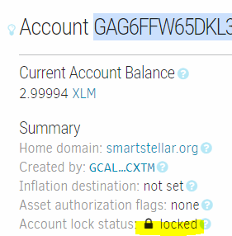
Blue Orion – Token Workshop
Optional: Limit Number of Total Available Tokens
On stellar.org/laboratory
Reduce master weight to 0
Set Thresholds to 1
This is optional!
Note: After executing this, there is no way to issue more tokens! Point of no return!

Slide 48
Blue Orion – Token Workshop
A4 Worshop Activity
Create Token on Publicnet
Create Issuer Account
Create Trustline on Distribution Account
Transfer Tokens from Issuer to Distribution Account
Optional: Limit Token Number

Slide 49
Blue Orion – Token Workshop
What next?
Transfer your tokens to friends
Other usecases -> services: security token (crowdfunding), usibility token for online applications

Slide 50
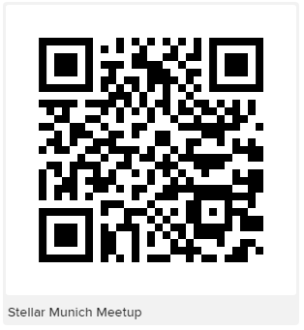
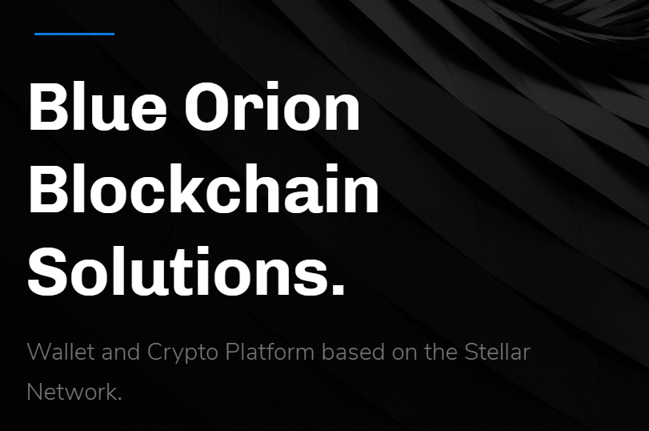
Thank You
Hans Woppmann
Phone: +49 176 6093 9333
Peter Pansegrau
Phone: +49 163 166 3738
eMail: contact@blueorion.cc
Twitter: twitter.com/blueorioncc

